Slide 1
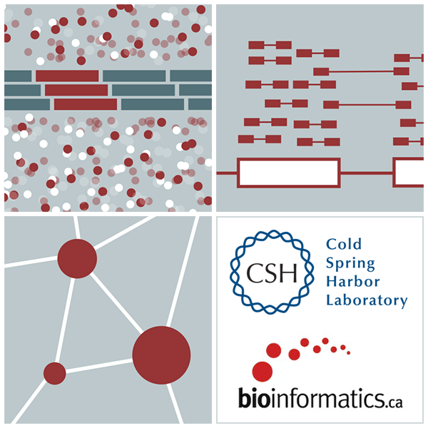
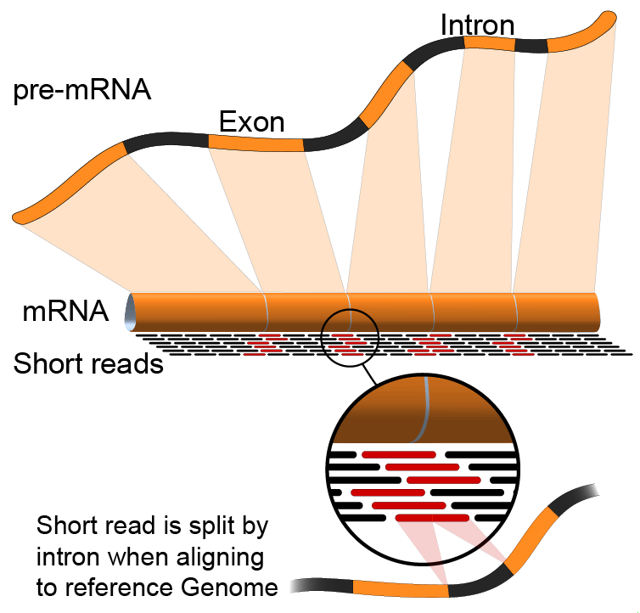

Module 0:
Introduction to cloud computing
Arpad Danos, Felicia Gomez, Obi Griffith, Malachi Griffith,
My Hoang, Mariam Khanfar, Chris Miller, Kartik Singhal
Advanced Sequencing Technologies & Bioinformatics Analysis November 10-23, 2024
Notes:
My name is …

Slide 2
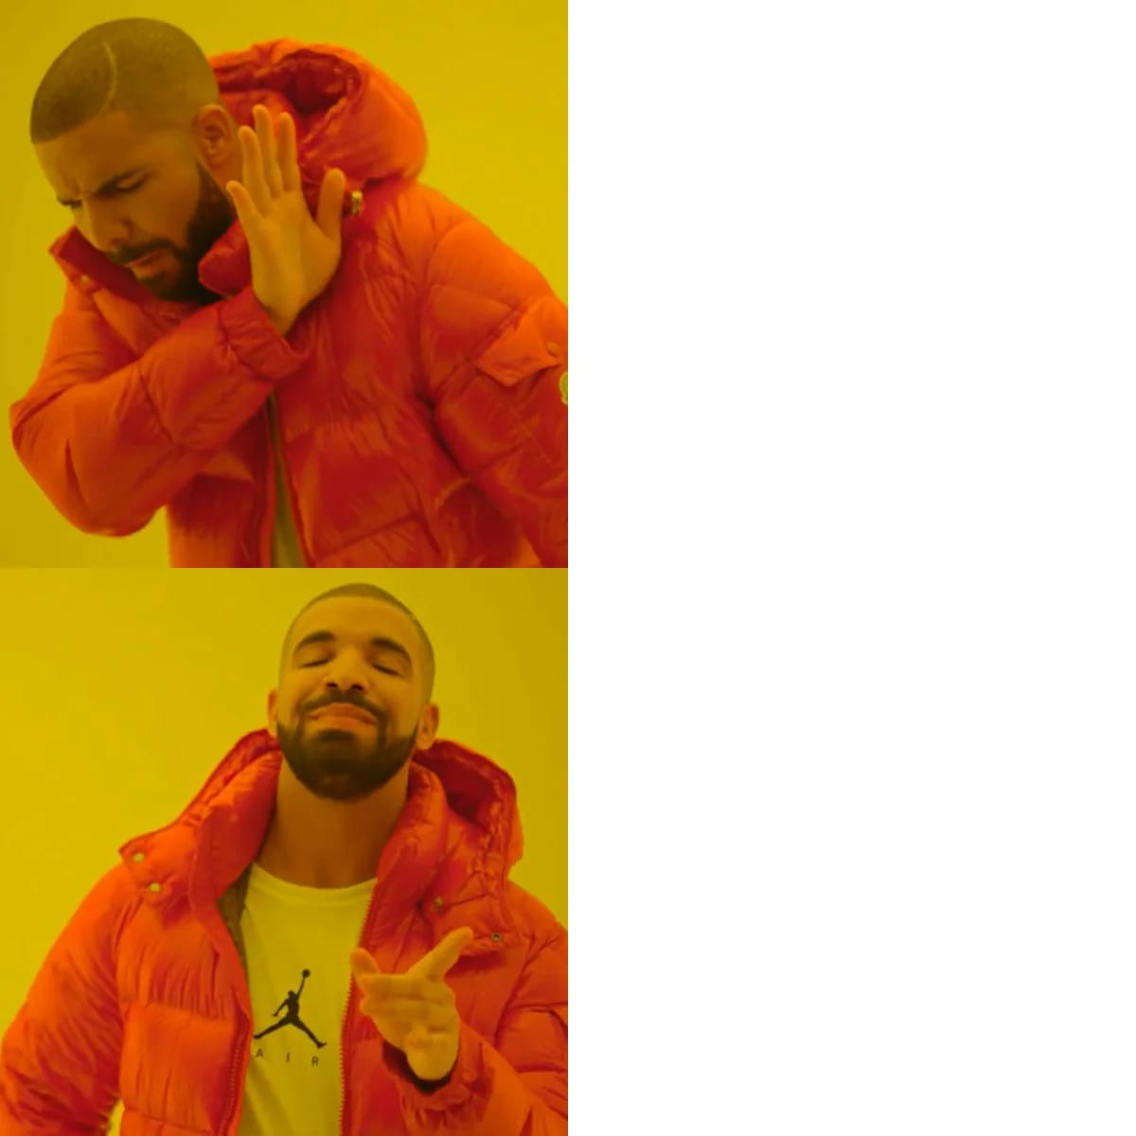
Motivation for using cloud computing in this course
Download 50+ packages on 20+ different computers
Use cloud computing service, create 1 public image with all packages, and clone that
Notes:
I’ll let you in on a secret

Slide 3
Learning Objectives
Introduction to cloud computing concepts
Introduction to cloud computing providers
Use the Amazon EC2 console to create an instance for each student
Will be used for many hands-on tutorials throughout the course
How to log into your cloud instance

Slide 4

Disk Capacity vs Sequencing Capacity, 1990-2012
Disk Storage
(Mbytes/$)
DNA
Sequencing (bp/$)
1,000,000
1,000,000,000
100,000
100,000,000
10,000,000
10,000
Hard disk storage (MB/$)
Doubling time=14 mo
1,000,000
1,000
100,000
100
10,000
Nextgen sequencing (bp/$)
Doubling time=4 mo
1,000
10
100
Pre-nextgen sequencing (bp/$)
Doubling time=19 mo
1
10
0
1990
1992
1996
1998
2000
2002
2004
2006
2008
2010
1
1994
2012
Notes:
The amount of sequencing data we can produce is growing faster than the increasing disk availability per dollar

Slide 5
About DNA and computers
We hit the $1000 genome* in ~2016
Need to think about the $100 genome
The doubling time of sequencing has been ~5-6 months.
The doubling time of storage and network bandwidth is ~12 months.
The doubling time of CPU speed is ~18 months.
The cost of sequencing a base pair will eventually equal the cost of storing a base pair
Notes:
The doubling time of sequencing is much shorter than the doubling time of storage and network bandwidth, CPU speed

Slide 6
What is the general biomedical scientist to do?
Lots of data
Poor IT infrastructure in many labs
Where do they go?
Get bigger hardware?
Write more grants?

Slide 7
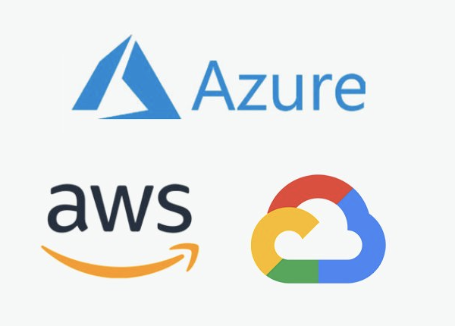
Cloud computing providers
Amazon AWS
https://aws.amazon.com/
Google cloud
https://cloud.google.com/
Microsoft Azure
https://azure.microsoft.com/en-us/
More…

Slide 8
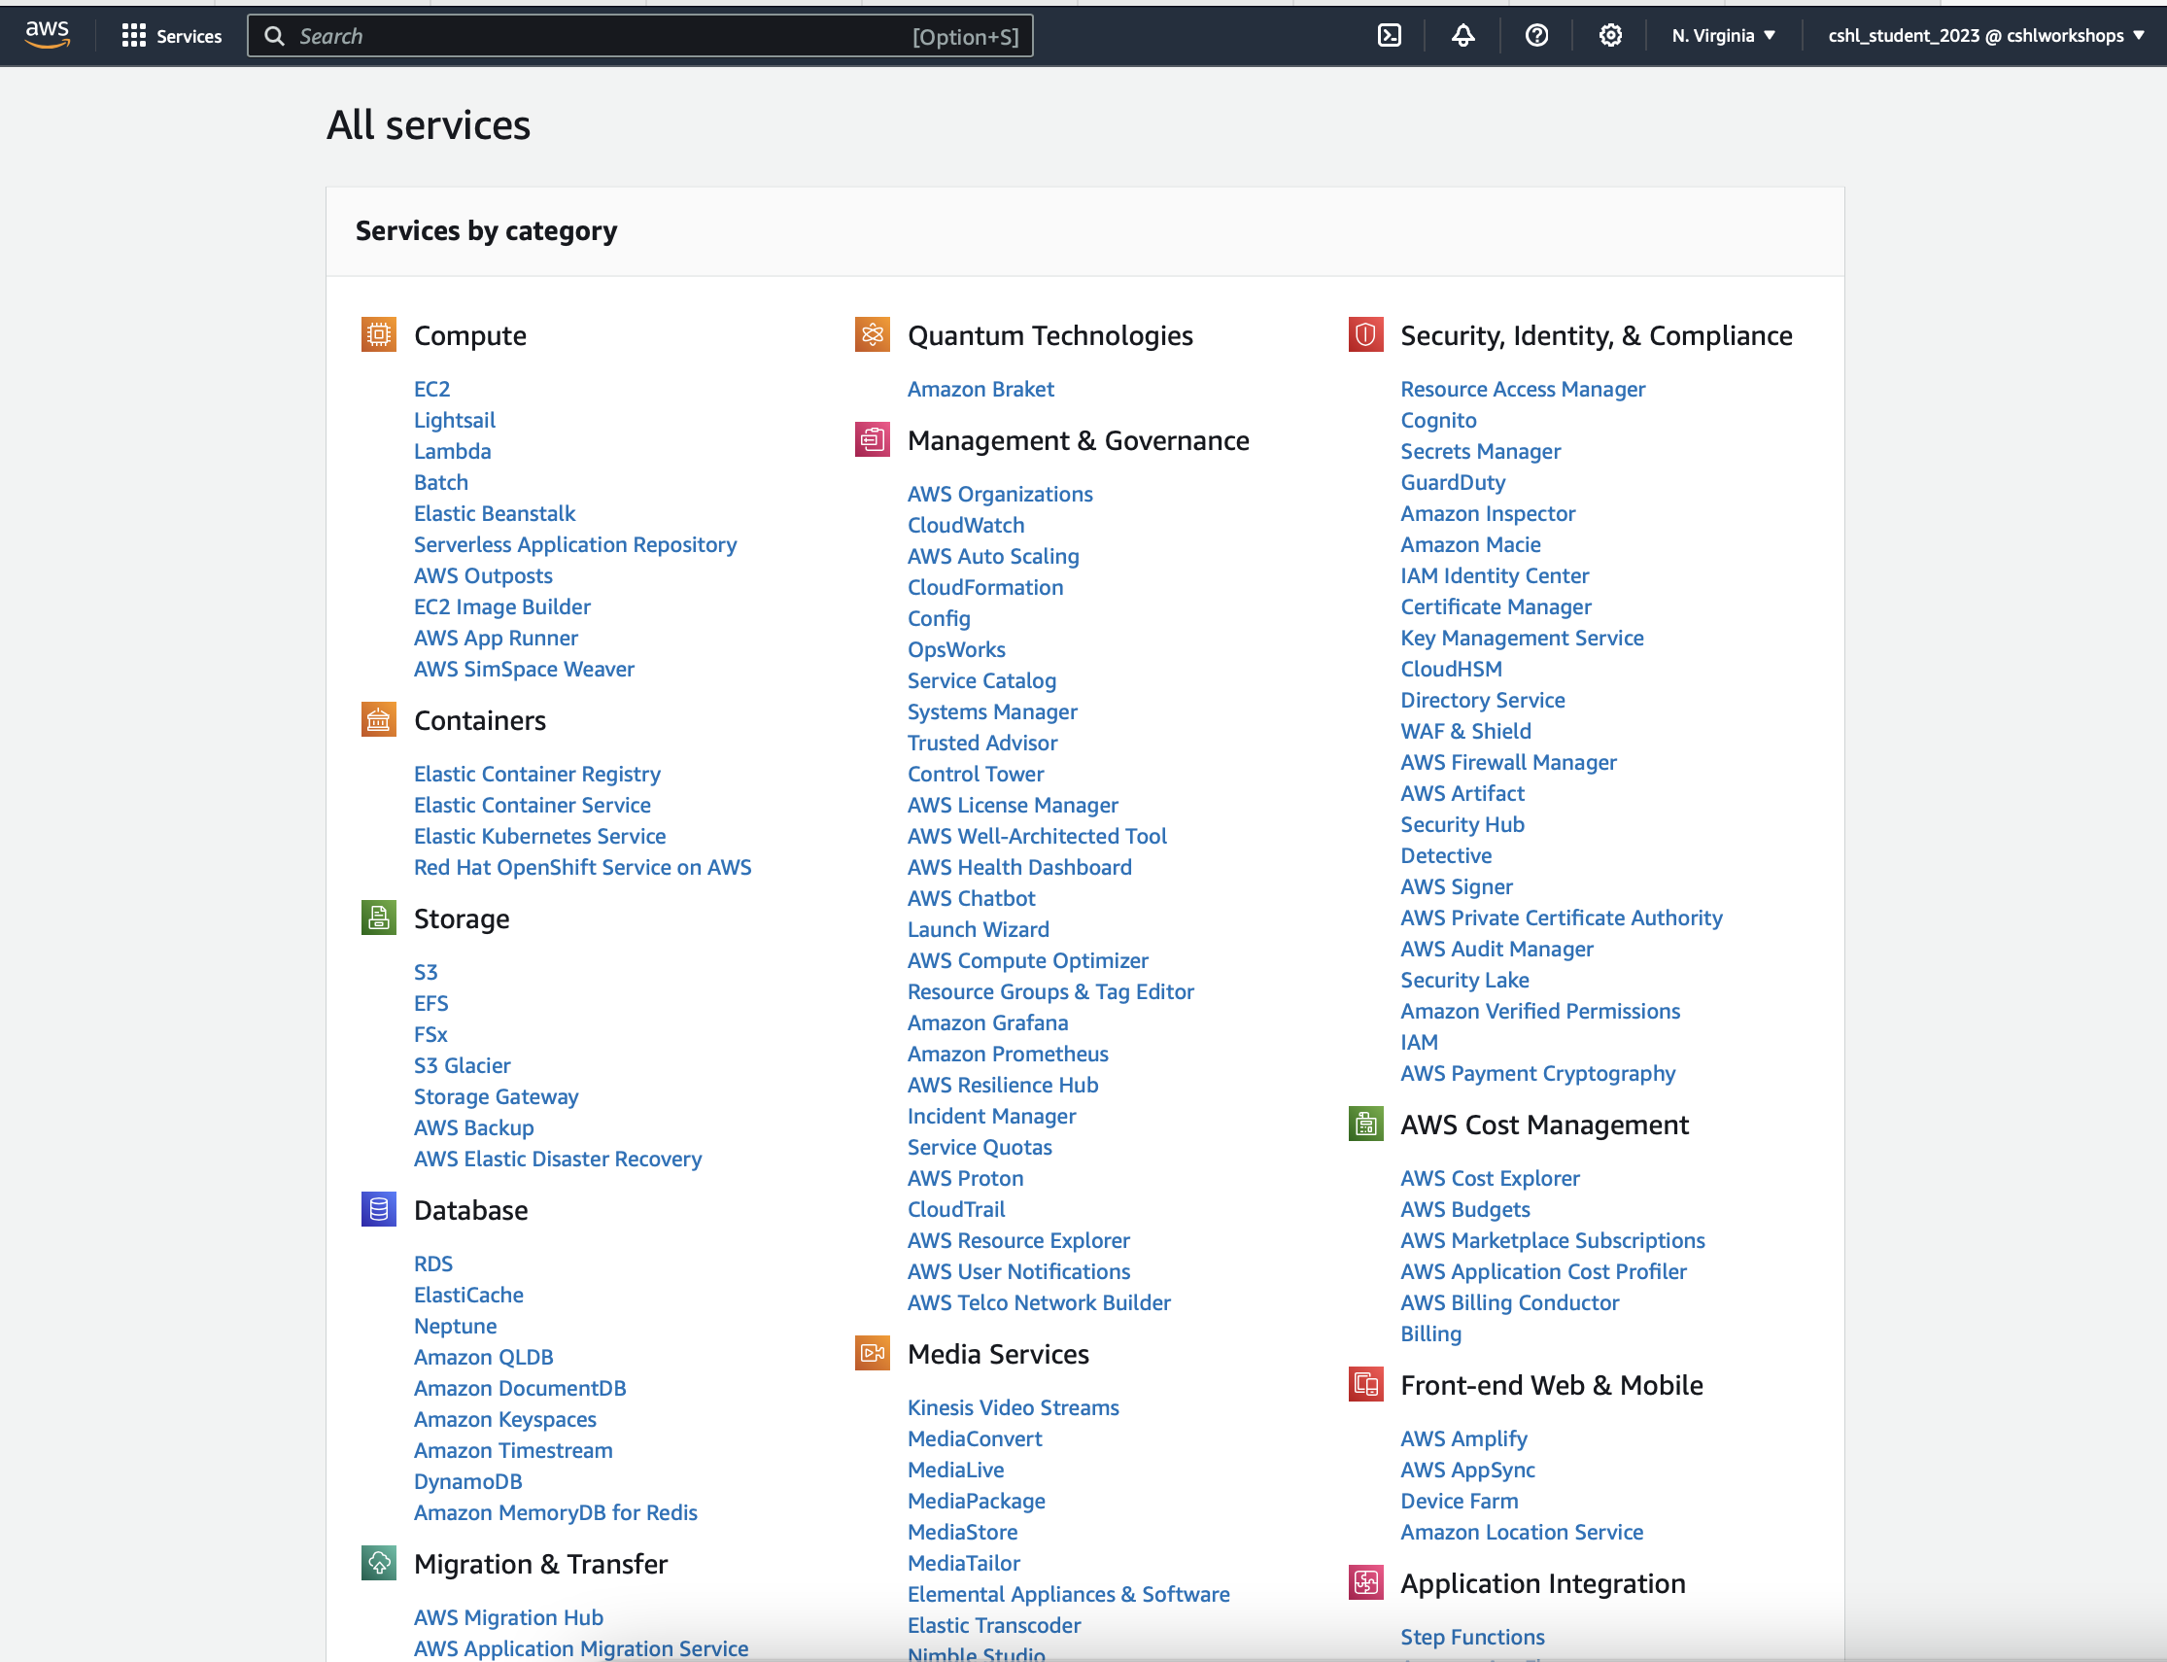
Amazon Web Services (AWS)
Notes:
For this course, We will use amzon web service , but most concepts are similar to other major cloud providers
The service we will use primarily is EC2

Slide 9

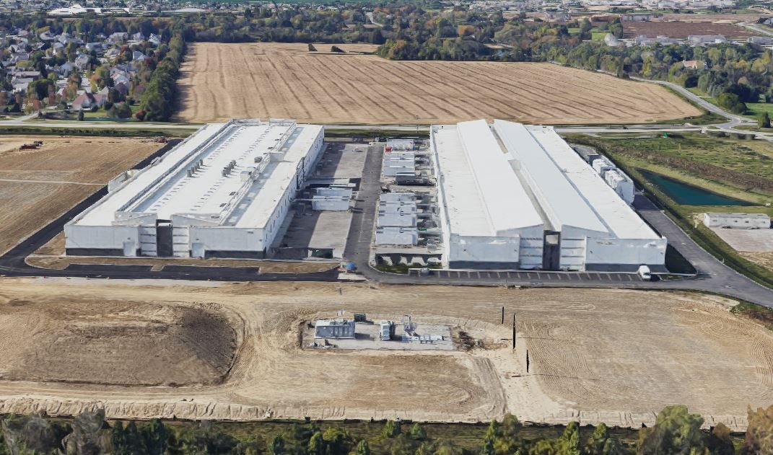
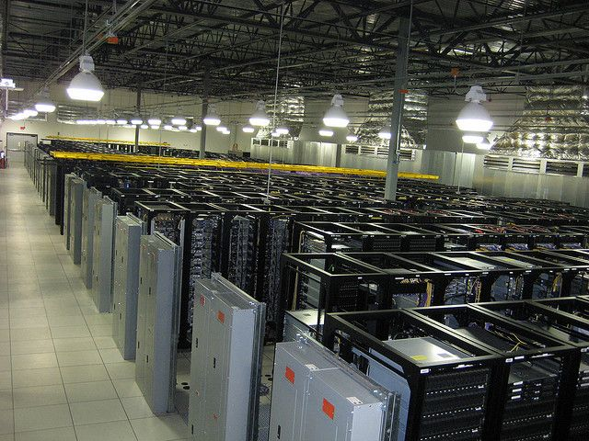
Amazon Web Services (AWS)
Compute per hour: EC2 (elastic cloud computing)
Infinite storage (scalable): S3 (simple storage service)
Ready when you are High Performance Computing
Multiple football fields of HPC throughout the world

Slide 10

EC2 (ECC)
Elastic: can increase or decrease capacity dynamically
Cloud: internet, or intranet
Compute: program
-> An AWS service that allows you to configure and rent computers to meet your compute needs on an as needed basis.

Slide 11



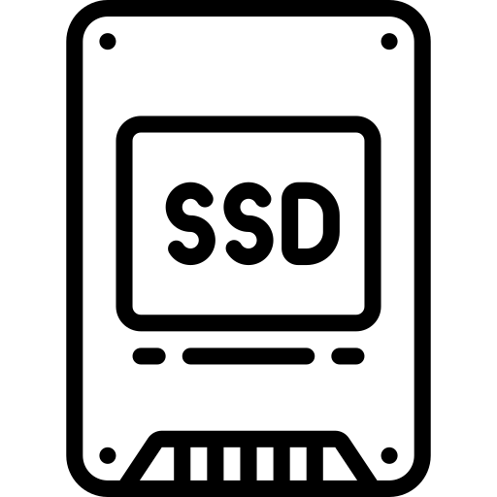
Types of volumes on your instance (rented computer)
+
Root volume
Additional EBS volume
EBS
(elastic block storage)
Storage volume that can be attached to an EC2 instance to provide additional storage.
Notes:
Root Volume: This is the primary volume attached to an EC2 instance when it is launched. It contains the operating system and boot files, allowing the instance to start and run. EBS Volume: These are additional volumes that can be attached to an EC2 instance to provide additional storage.

Slide 12

EC2
(elastic cloud computing)
Compute per hour
S3
(simple storage service)
Infinite storage
Notes:
EC2: data in here: instant access
S3: long term access

Slide 13
Some of the challenges of cloud computing:
Not cheap
Getting files to and from there
Standardization can be a challenge if you don’t control hardware
PHI: personal health information & security concerns
In the USA: HIPAA act, PSQIA act, HITECH act, Patriot act, CLIA and CAP programs, etc.
http://www.biostars.org/p/70204/

Slide 14
Some of the advantages of cloud computing:
There are better ways of transferring large files, and now AWS makes it free to upload files.
A number of datasets exist on AWS (e.g. 1000 genome data, TCGA).
Many useful bioinformatics AMI’s (Amazon Machine Images) exist on AWS: e.g. cloudbiolinux & CloudMan (Galaxy) – now one for this course!
Many flavors of cloud available, not just AWS

Slide 15
Quick summary
EC2 = where we rent virtual computers (instances)
That we can start, stop, expand as needed to save computing cost

Slide 16
What is difference between the 'Start', 'Stop', 'Reboot', and 'Terminate' (Instance States)?
Start – turn on an EC2 instance that you have previously created
Stop – turn off an EC2 instance that you have previously created
Reboot – restart an EC2 instance
Terminate – permanently stop and destroy an EC2 instance. Any associated EBS volumes may also be destroyed at this time depending on configuration
Notes:
Things you can do:
…
We will get into the habit of start/stop instances ~ when we do so, we are saving money for the course

Slide 17




What is an AMI/snapshot?
+
Snapshot
AMI (Amazon Machine Image)
(Instance with Useful packages and datasets)

Slide 18
What is an AMI/snapshot?
+

Slide 19
What is an AMI/snapshot?
AMI (Amazon Machine Image) – a template that specifies how to launch EC2 instances
Root volume with operating system (OS), pre-installed applications, etc
Launch permissions the determine who can use the AMI
Specification of (data) volumes to attach when launched
You can create an AMI for any instance you have created/configured
AMI can be made public for sharing (region-specific)
Creating an AMI involves creating a snapshot of the root and any attached volumes. You will be charged to store this snapshot.
Notes:
You set up a root volume with an operating system: mac, window, linux
You start an instance ~ which is just computer, then you attach hard drive into it. You get to a point when you like your setting ~ you can create a snapshot or clone your computer right now, and save it for later, so you can always go back to that. (if you are a gamer, it’s Save mode)
That AMI can be made public.
Create ami involves … . There’s a cost associated with long term storage of them.

Slide 20
I can not log into my EC2 instance, what might have gone wrong?
Is your instance running?
Are you providing the correct path to your key file?
Is it the correct key file?
Have you set the permissions for your key file correctly?
Did you specify a valid user for your AMI (e.g., ubuntu)?
Did you specify the correct IP address?
Does the Security Group for the instance allow access for your connection protocol (e.g., SSH) and location?
Notes:
Did you specify the correct IP address? ~ this is a common gotcha since it changes day to day.

Slide 21
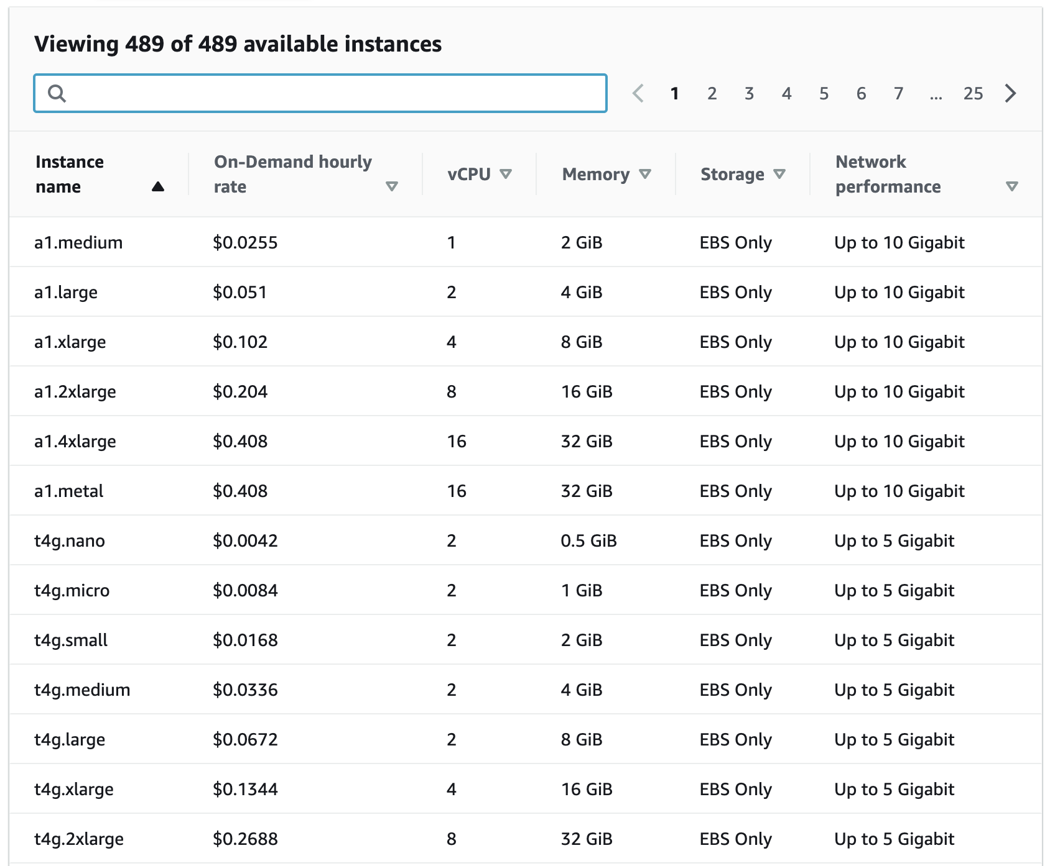
How much does it cost to use AWS EC2 resources?
Data transfer (GB): In: free; Out: first 100 GB free, $0.05-0.09 per GB depending on amount EBS storage (GB/Month): $0.08 S3 storage (GB/Month): $0.023 standard, $0.0125 infrequent access, or $0.004 glacier
Notes:
We will use m6a.xlarge which cost …
These sound cheap, but when you have Terabytes of data, it can add up.
Way to save money: moving data to cheaper storage.

Slide 22
Why am I still getting a monthly bill?
Generally you get an accounting of usage and cost on a 30 day cycle
Pricing is per instance-second consumed for each instance type.
Also charges for storage, transfers, etc
Be aware of regions!
Even when an instance is stopped, storage for root or other EBS volumes persist
Creating AMIs/snapshots requires storage
Explore the billing and cost management tools of AWS to track your spending, set warnings, etc
Notes:
Sometimes you get unfortunate surprise by this monthly billing.
Be aware of regions: if you have an instance in Oregon, and forget about it, cost will add up. And will see it at the end of the month.

Slide 23
Amazon AWS documentation
https://rnabio.org/module-00-setup/0000/06/01/Intro_to_AWS/
http://aws.amazon.com/console/
Notes:
So that’s the quick intro cloud computing
Link to console ~ we will have a unique link to our console

Slide 24
In this workshop:
Some tools (data) are
on your computer
on the web
on the cloud.
You will become efficient at traversing these various spaces, and finding resources you need, and using what is best for you.
There are different ways of using the cloud:
Command line (like your own very powerful Unix box)
With a web-browser (e.g. Galaxy): not in this workshop

Slide 25
Things we have set up:
Loaded data files to a web server (genomedata.org)
We started with a base Ubuntu 22.04 (Linux) instance and loaded a whole bunch of software for NGS analysis.
We will copy this and create separate instances for everybody in the class.
We’ve simplified the security: you basically all have the same login and file access, and opened ports. In your own world, you would be more secure to protect your data.
Notes:
We have simplified the security: you all have the same log in, file access, open ports.
In your own world, you wont want to do this: you would want to create your own key to be more secure to be able to protect your data.

Slide 26
Logging into Amazon AWS

Slide 27
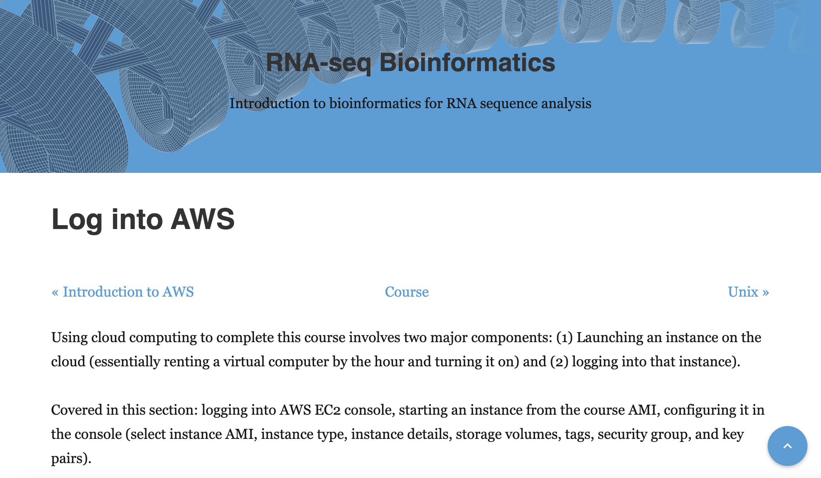
Go to course wiki, “Log into AWS” page
https://rnabio.org/module-00-setup/0000/07/01/Log_into_Compute/
Notes:
Now if you go to the course wiki, we have instruction : we have a link in the course page.

Slide 28
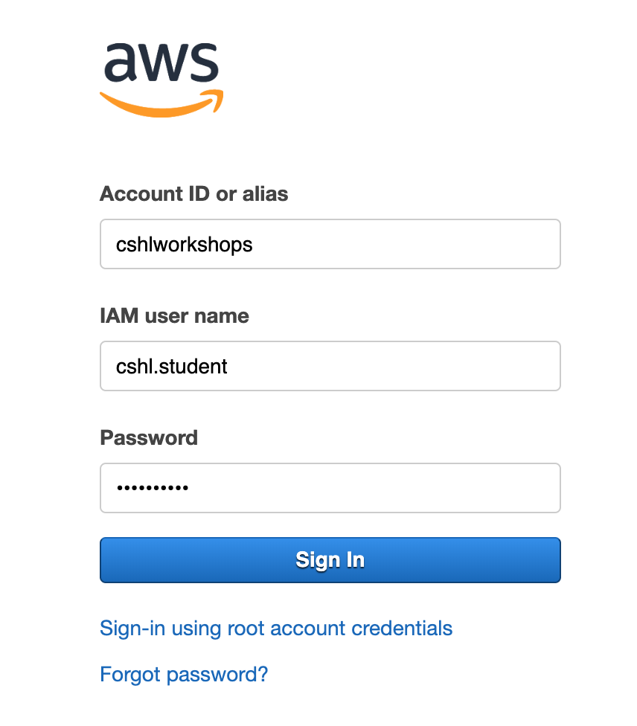
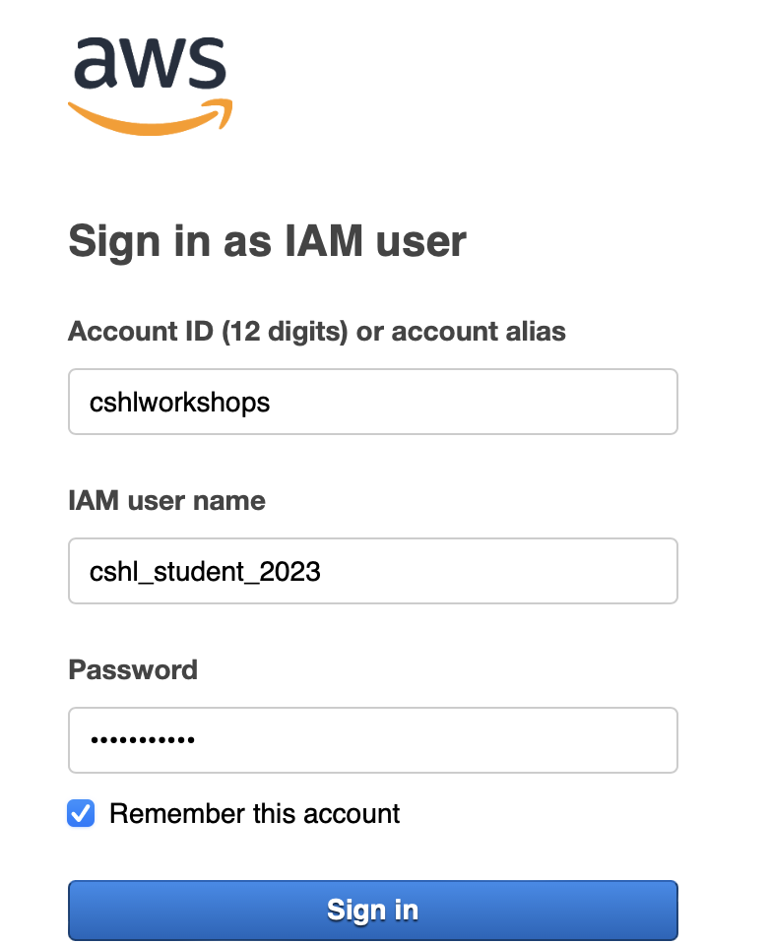
Login to AWS console
cshl_student_2024
https://cshlworkshops.signin.aws.amazon.com/console

Slide 29
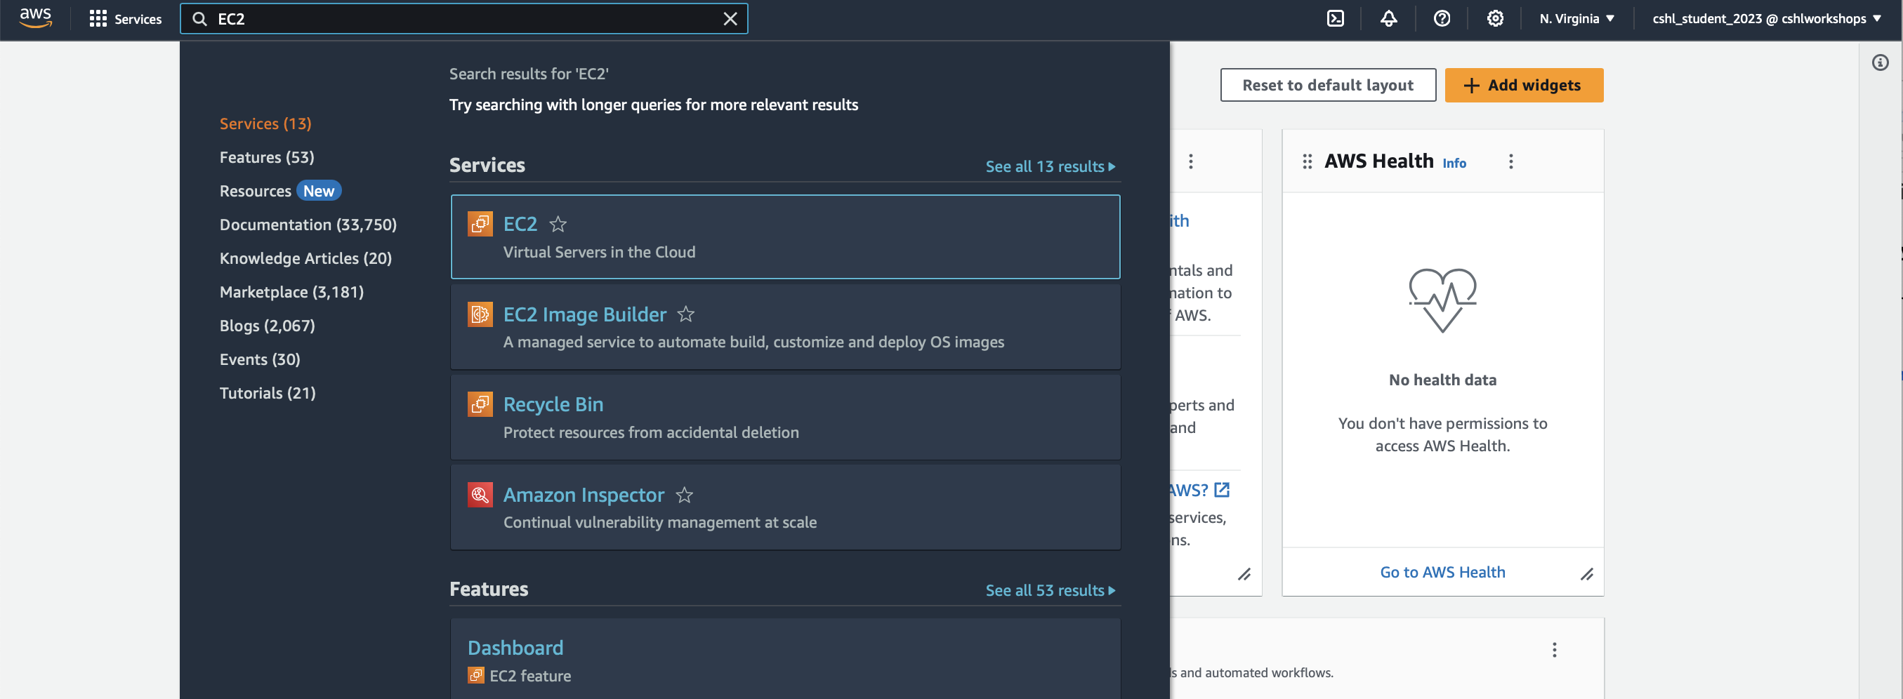
Select "EC2" service
Search for EC2
Make sure you are in N. Virginia region

Slide 30
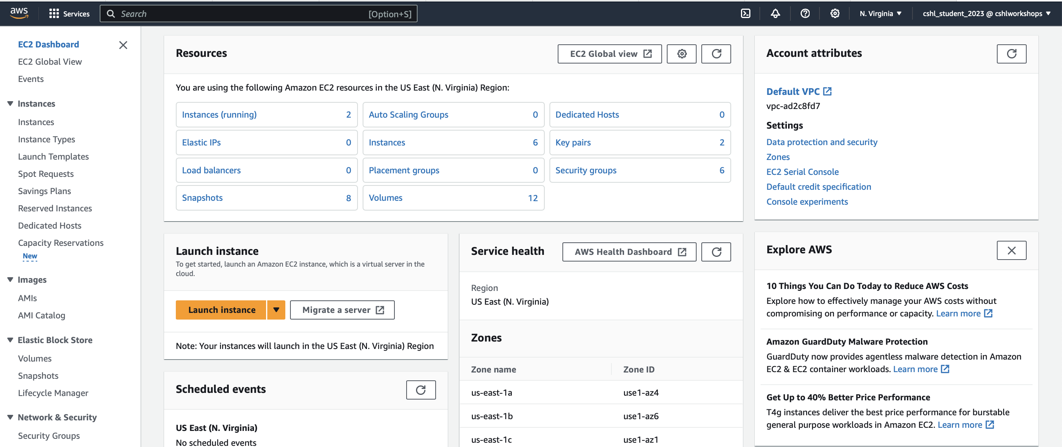
From EC2 Dashboard, launch a new Instance

Slide 31
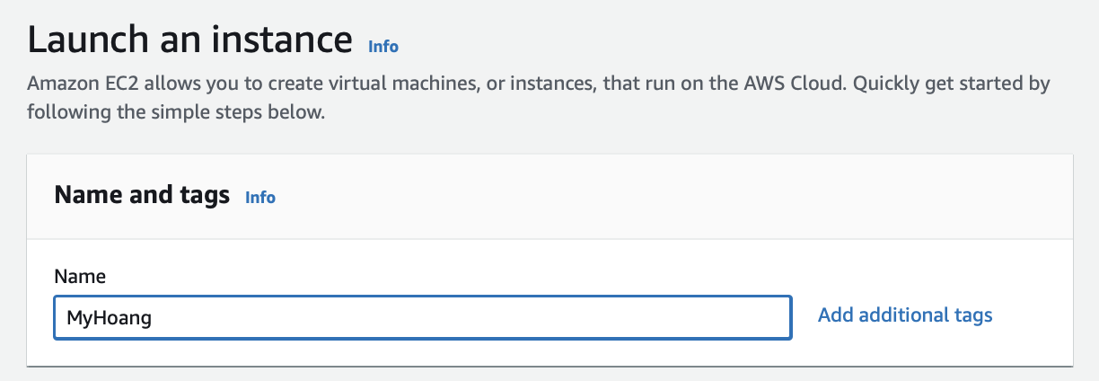
Name your instance “FirstnameLastname” (e.g. MyHoang)
Important: Don’t forget to name your instance!
(FirstnameLastname)
Notes:
Very important: since we have many instances, to avoid logging in to the same instance, name instance using your name.

Slide 32
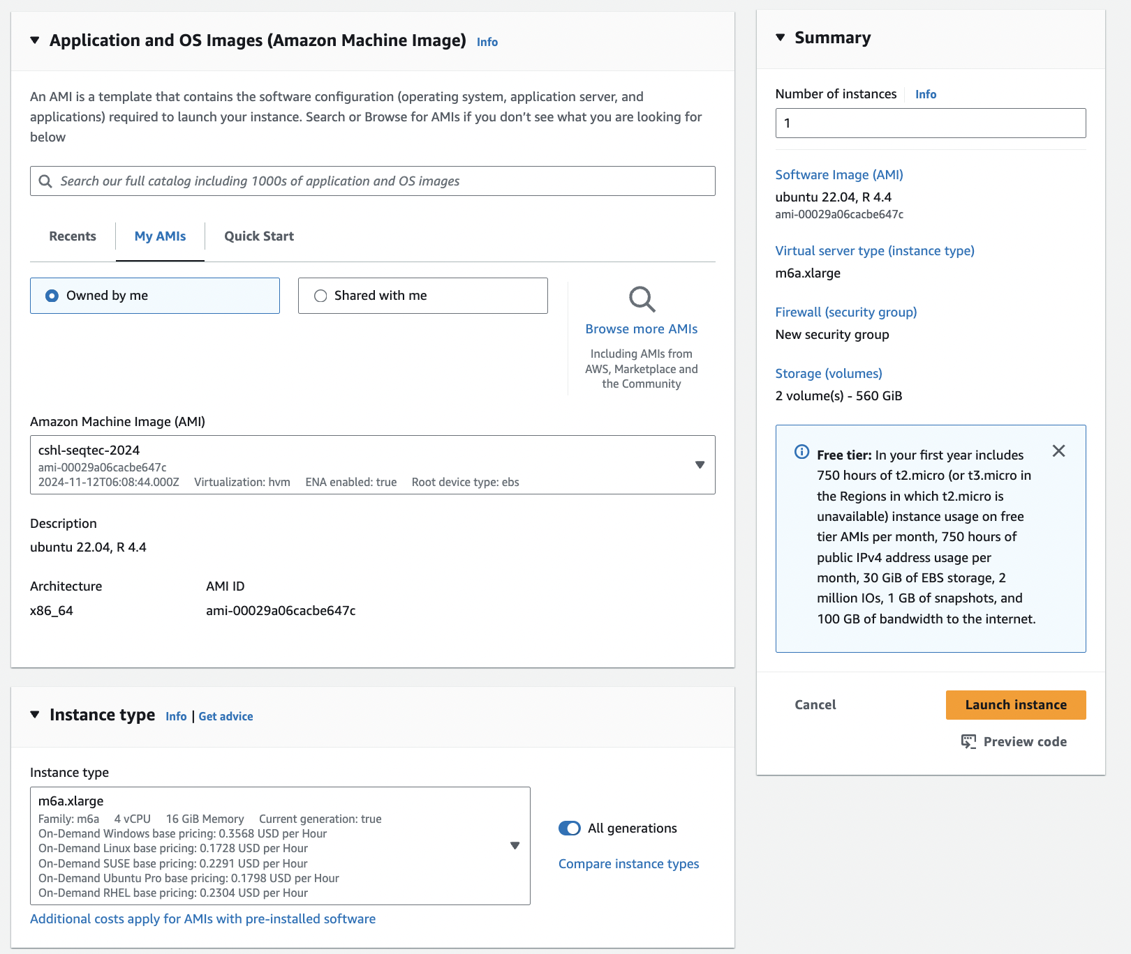
Choose an AMI – Find the cshl-seqtec-2024 AMI in the My AMIs

Slide 33
Choose “m6a.xlarge” instance type, then "Next: Configure Instance Details".

Slide 34
cshl-seqtec-2024
+

Slide 35
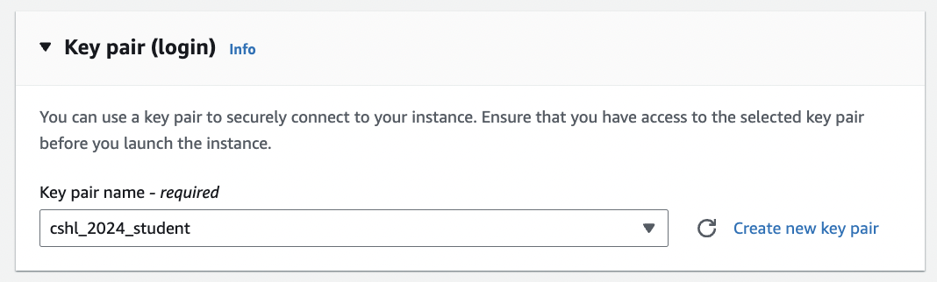
Choose an existing key pair: ”cshl_2024_student"

Slide 36
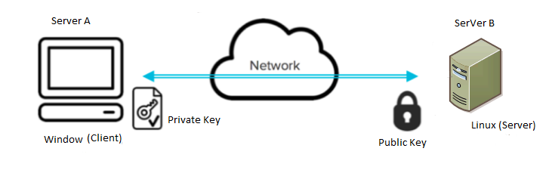
In this case: your computer
In this case: your aws instance

Slide 37
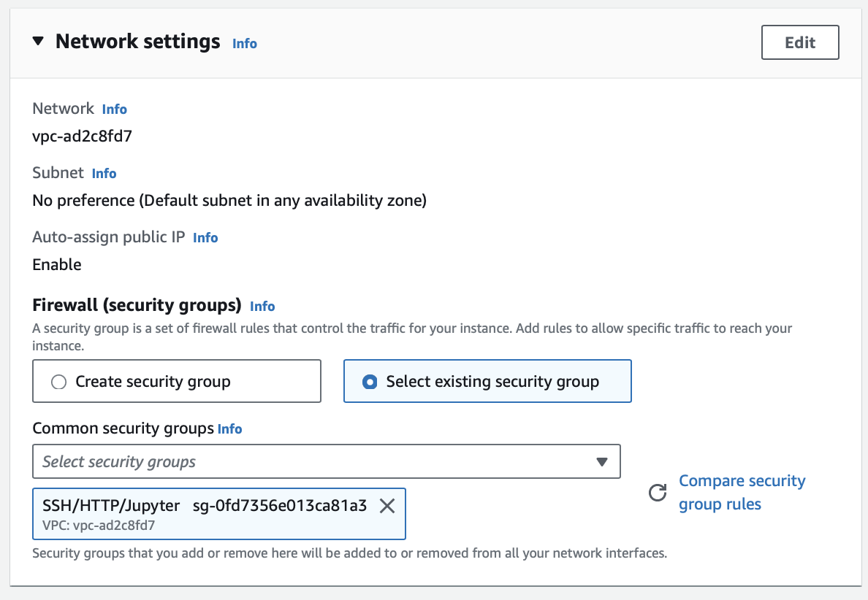
Select an Existing Security Group, choose "SSH/HTTP/Jupyter". Then hit "Review and Launch".
Notes:
We will allow SSH and HTTP access into it, from anywhere, basically.
Also set up certain port (port 8888) to allow jupyter access.

Slide 38
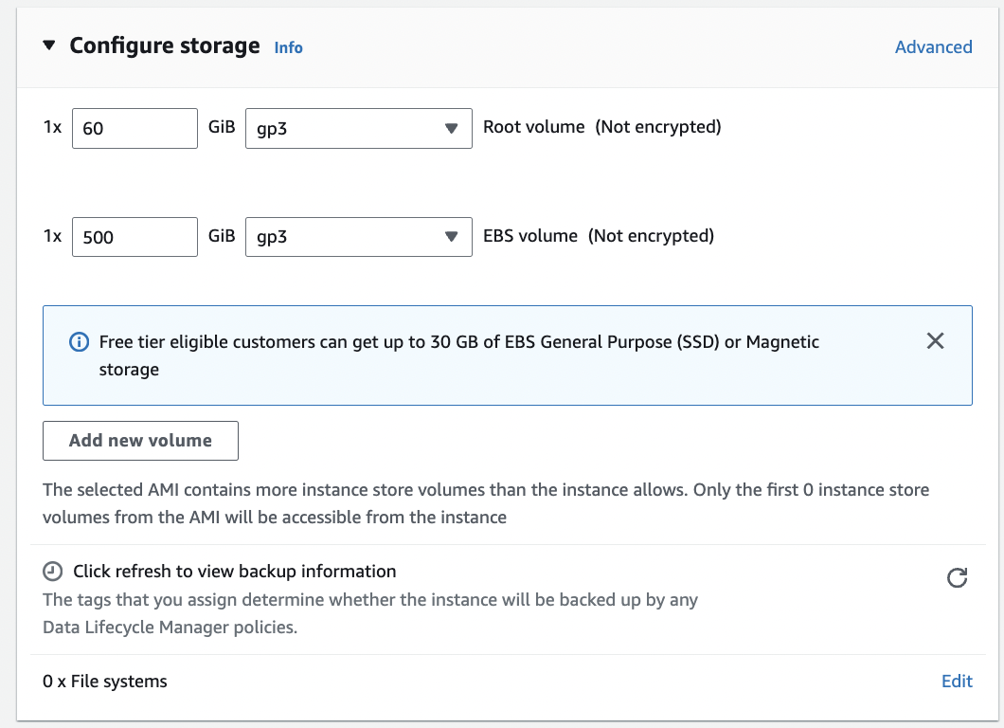
You should see 1x 60 GiB root volume and 1x 500 GiB EBS volume as the two storage volumes. Both of type gp3.
Notes:
Root volume: where most of the software system and tools live
The other one is where the data will go that we will download and compute on.

Slide 39
+
Root volume
60G
Additional EBS volume
500G

Slide 40
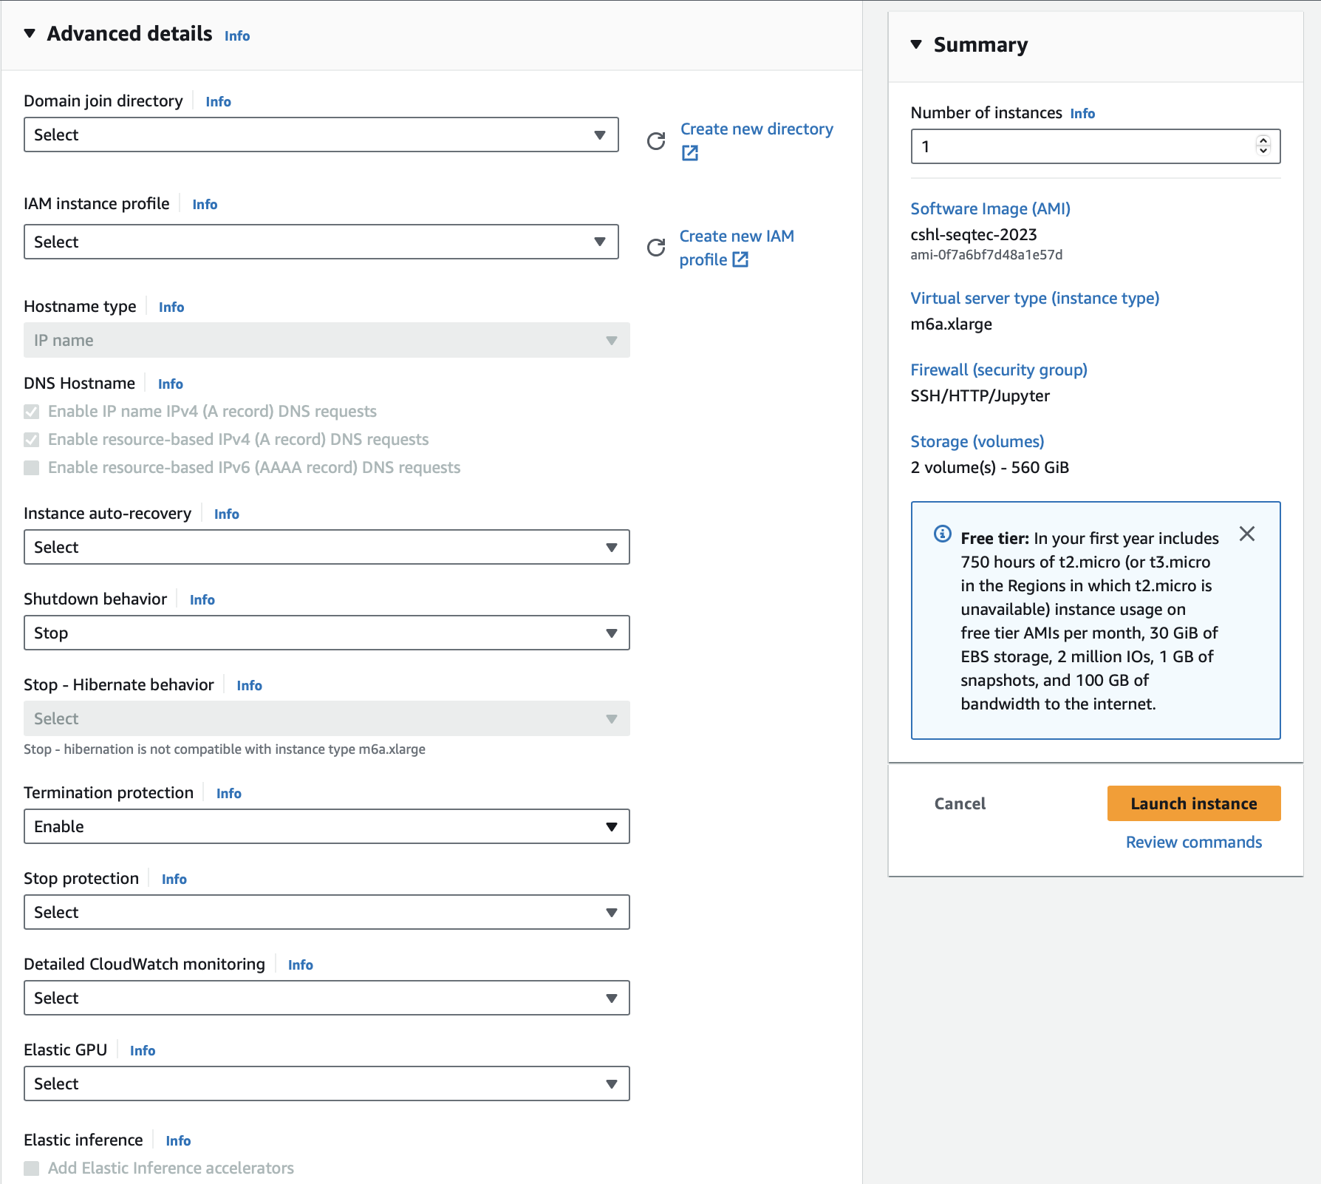
Select “Enable” for termination protection.

Slide 41
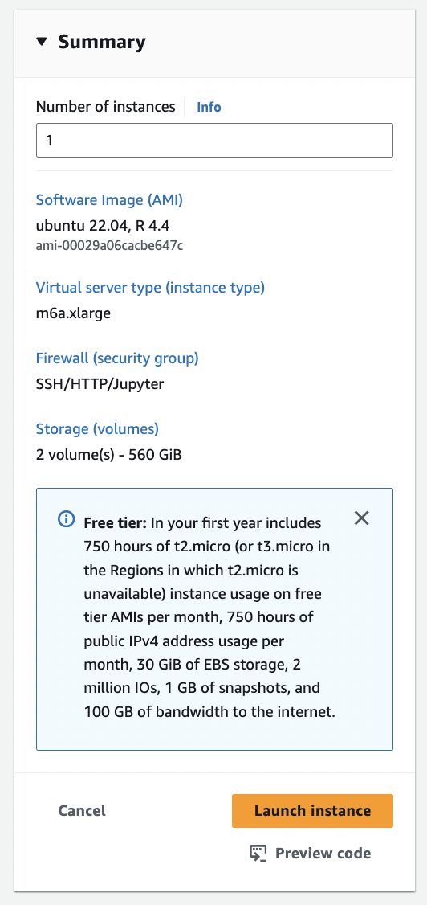
Review the details of your instance and hit Launch

Slide 42
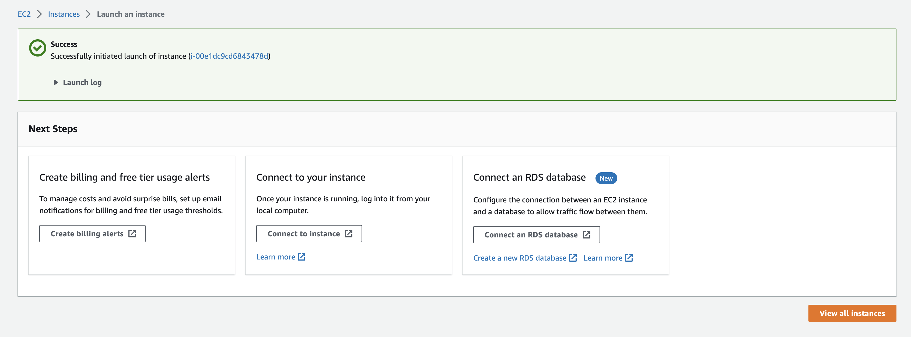
View Instances to see your new instance spinning up!

Slide 43
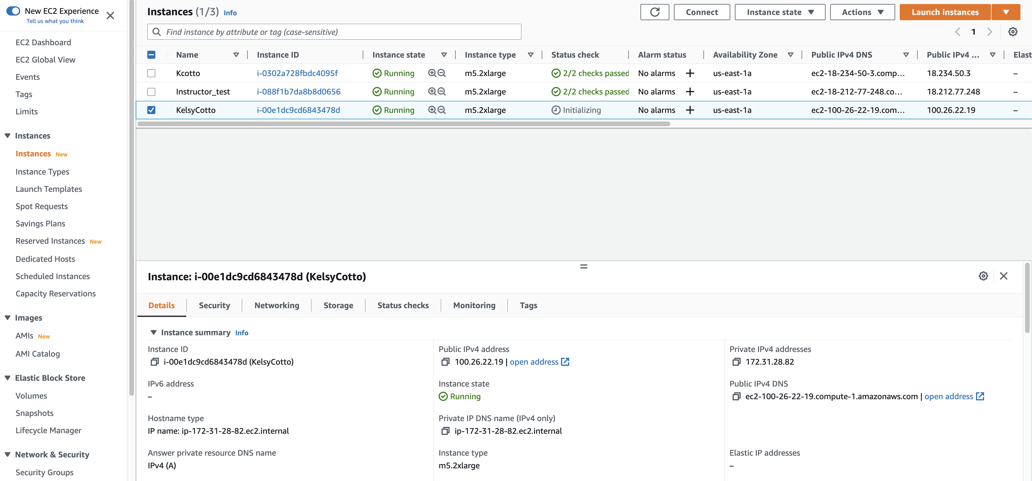
Find YOUR instance, select it, and then hit connect for instructions on how to connect (It may take some time for your instance to be ready)

Slide 44
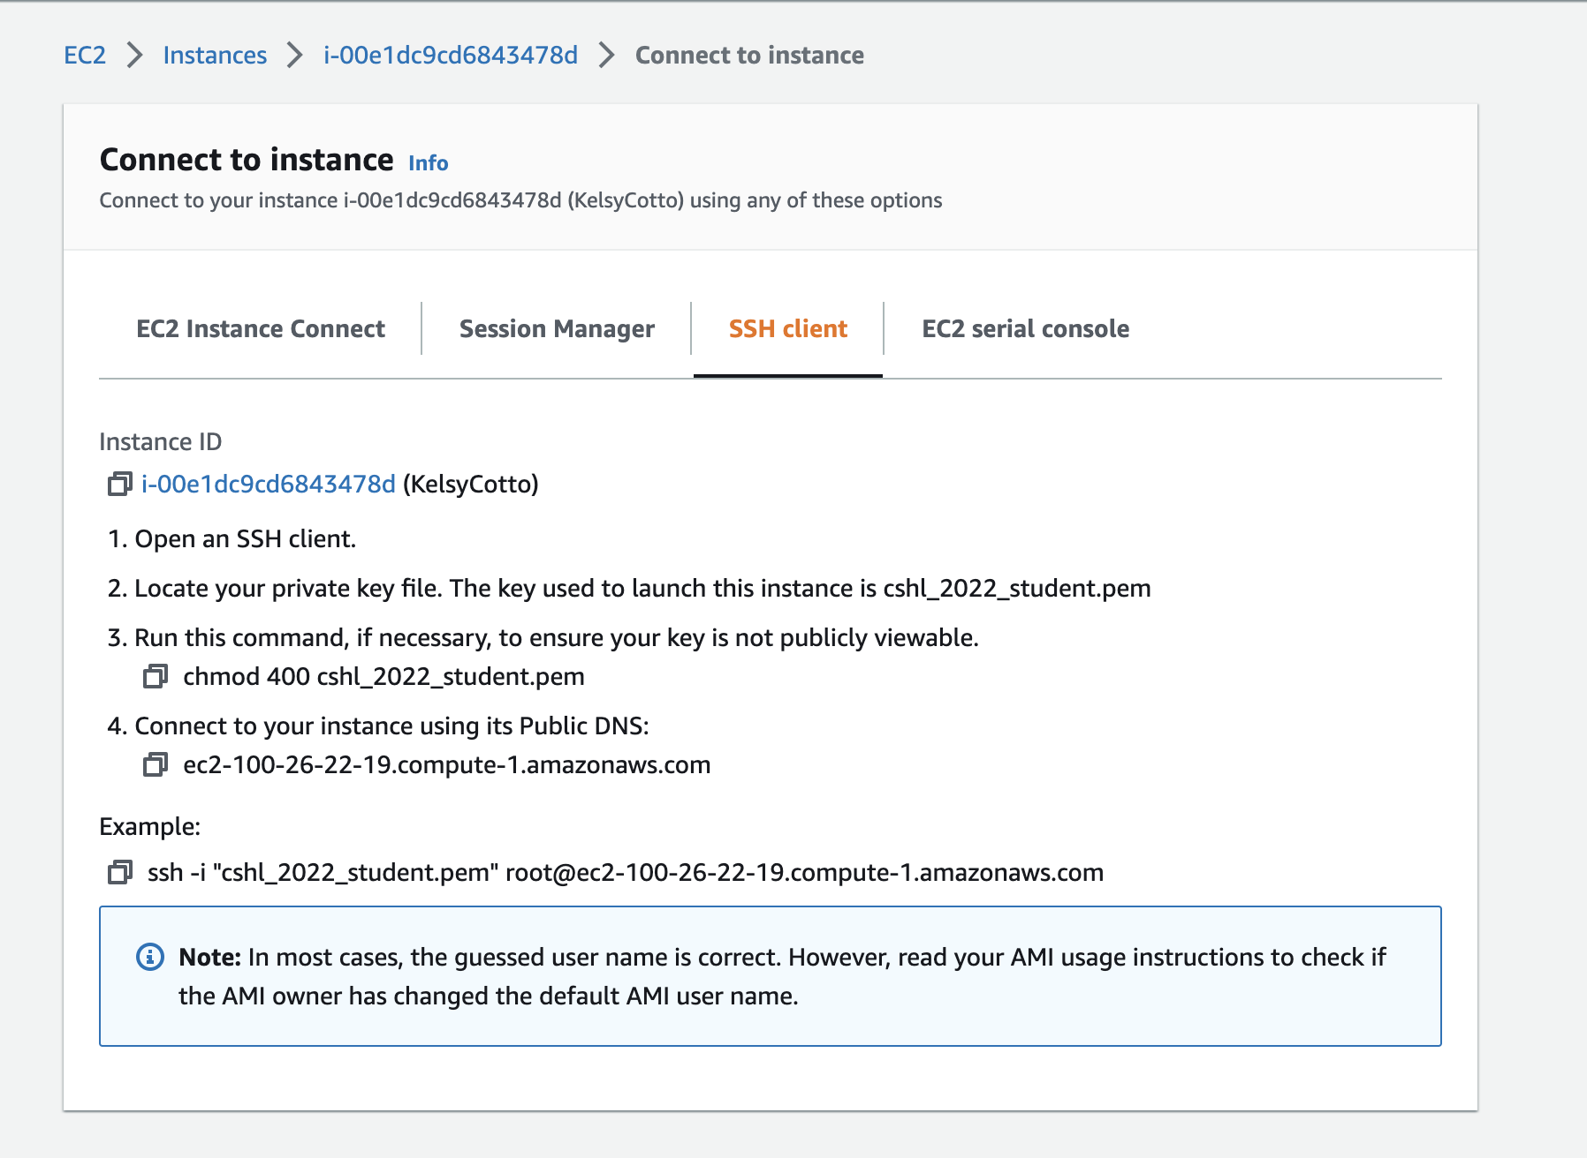
Take note of your Public DNS/IP and the instructions on changing permissions for the key file (Note, we will login as ubuntu NOT root)

Slide 45
Congratulations, you just fire your own instance!!
Let’s log into it

Slide 46
Steps
Launch instance : Done !
Step 0: Download key file (.pem file for Mac, .ppk file for Windows)
& Change permission of downloaded key
mac: chmod 400 cshl_2024_student.pem
windows: icacls cshl_2024_student.pem
Step 1: Log into your instance :
ssh -i cshl_2024_student.pem ubuntu@[public.ip.address]
When done for the day, ‘stop’ instance (don’t ‘terminate’). Next morning, ‘start’ instance again (don’t launch new instance).

Slide 47
Logging into your instance
Mac
Terminal
Window
PowerShell (preferred, similar to Terminal)
PuTTy (more complicated)

Slide 48
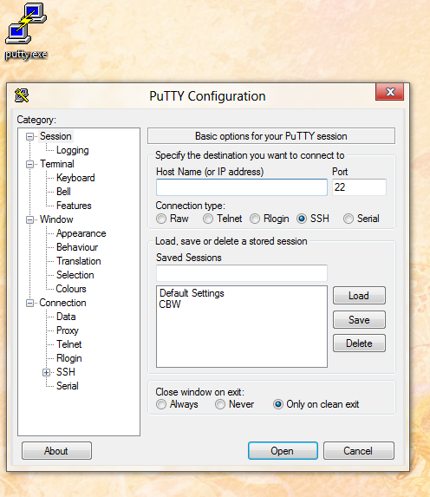
Logging into your instance (Windows)
Enter the Host Name (IP address)
Open PuTTY

Slide 49
Logging into your instance (Windows)
Choose Connection -> Data
Enter the username ‘ubuntu’
Choose SSH -> Auth
Browse to Private key (ppk) file

Slide 50
Logging into your instance (Windows)
Choose Session
Save your session as ”Amazon Node”
Double-click saved “Amazon Node” session OR
Select ”Amazon Node” session and click Open

Slide 51
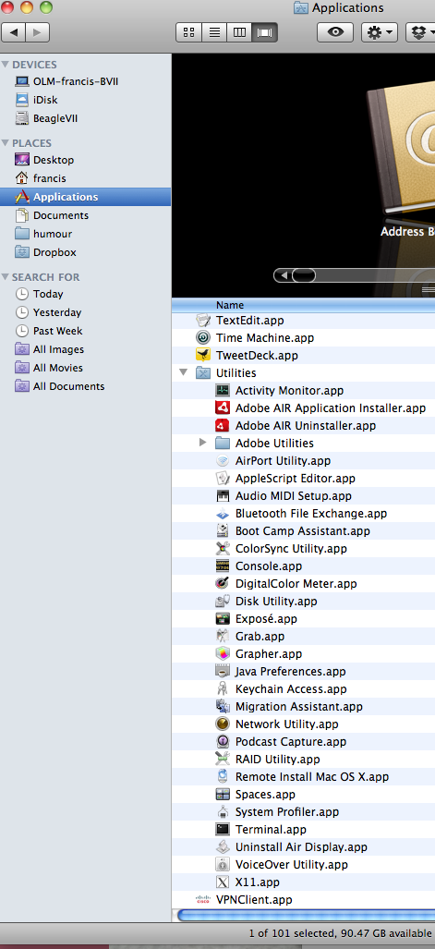
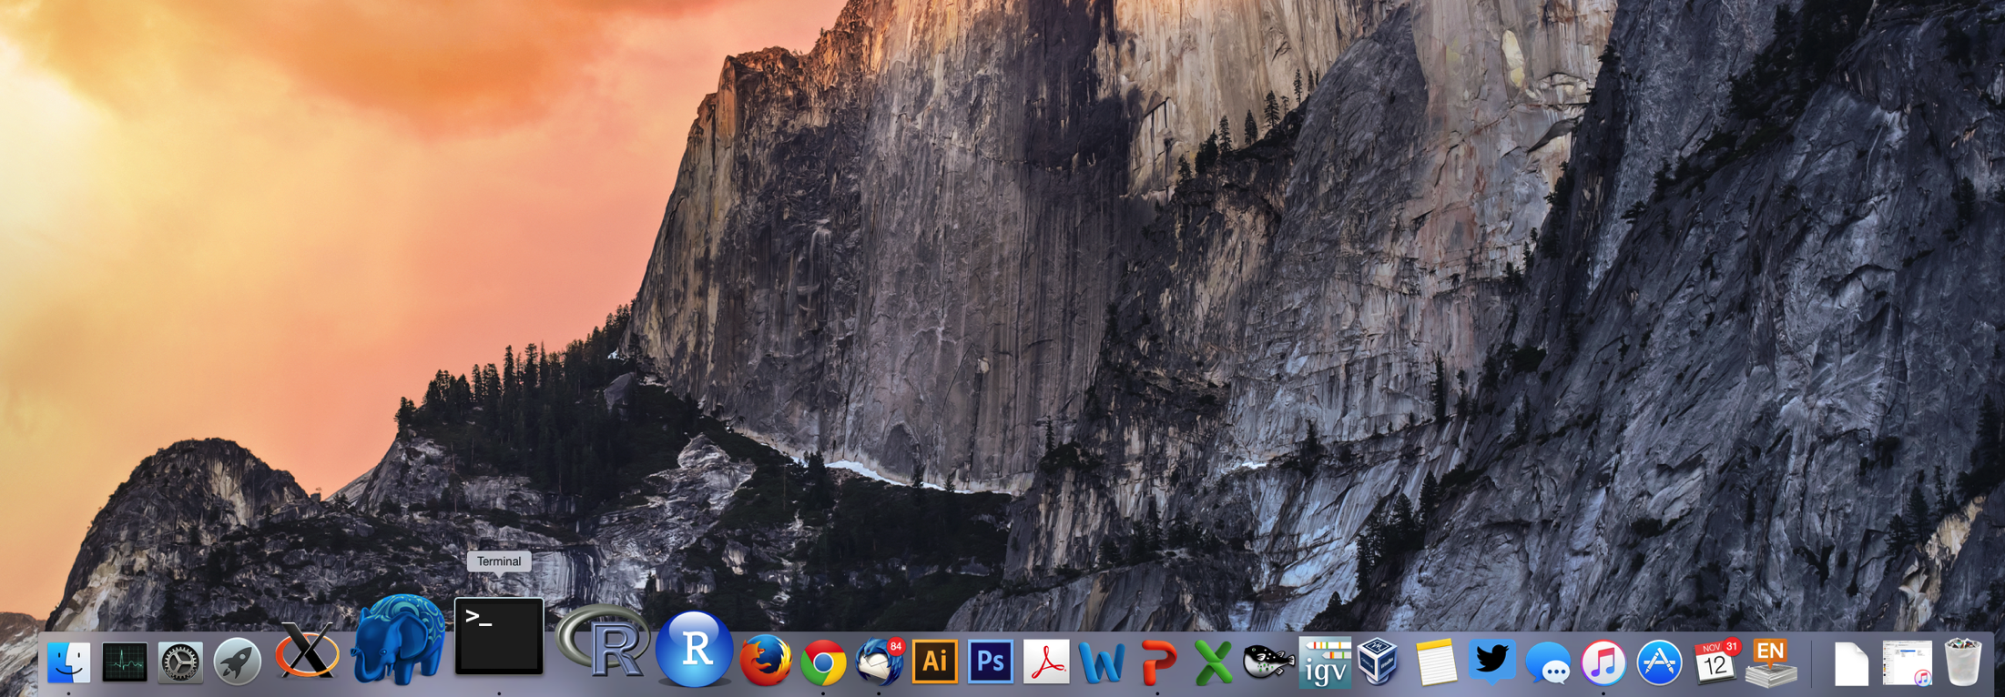
Logging into your instance (Mac)
In a Finder window
‘Applications’ -> ‘Utilities’ -> ‘Terminal’
Or on your dock

Slide 52
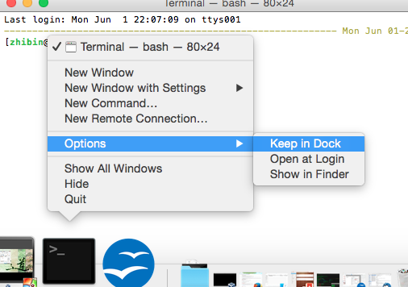
Add the terminal App to your dock

Slide 53
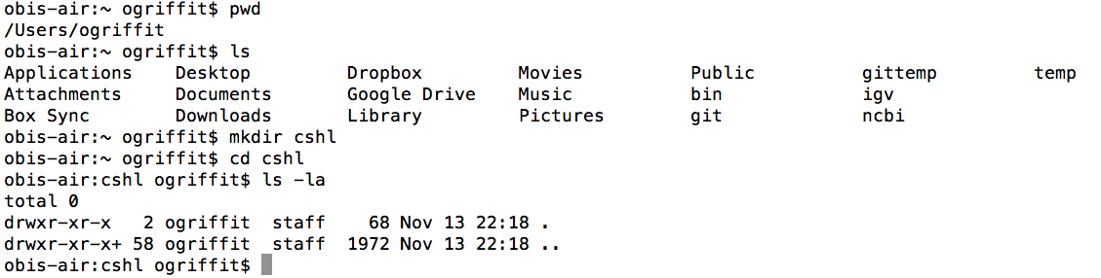
Creating a working directory on your Mac called ‘cshl’
mkdir cshl
cd cshl

Slide 54
Obtain the course SSH key file
NOTE for Mac users. You will need to use a “.pem” file
NOTE for Windows Users.
You can use the same ‘.pem’ file if use PowerShell
Or a ‘.ppk’ file. This can be created from the “.pem” file:
https://aws.amazon.com/premiumsupport/knowledge-center/convert-pem-file-into-ppk/
The SSH key file will be used to securely login to your student instance on the cloud
Save the pem/ppk file you received via email/slack to your new cshl folder

Slide 55
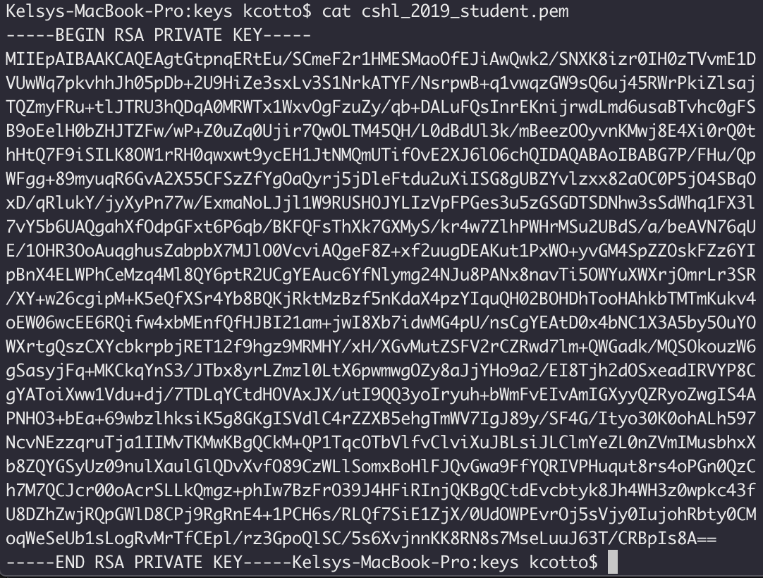
Viewing the ‘key’ file once downloaded
cat cshl_2021_student.pem
less cshl_2021_student.pem
Notes:
You can use the cat command to view the file.
Or my preferred way: use less

Slide 56
Changing file permissions of your ‘key’ file (Mac/Linux)
ls -l (long listing)
-rw-r--r--@ 1 kcotto staff 1696 Nov 9 09:19 cshl_2023_student.pem
rwx : owner
rwx : group
rwx: world
r read (4)
w write (2)
x execute (1)
Which ever way you add these 3 numbers, you know which integers
were used (6 is always 4+2, 5 is 4+1, 4 is by itself, 0 is none of them etc …)
So, when you have:
chmod 400 <file name>
It is “r” for the the file owner only

Slide 57
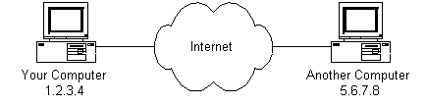
Logging into your instance
Mac/Linux
cd ~/cshl
chmod 400 cshl_2024_student.pem
(Windows: icacls cshl_2024_student.pem)
ssh -i cshl_2024_student.pem ubuntu@[YOUR PUBLIC IP]

Slide 58
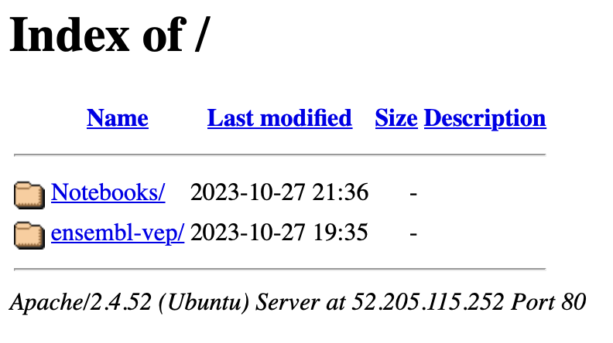
Copying files from AWS to your computer (using a web browser)
http://[YOUR PUBLIC DNS OR IP]/

Slide 59
Logging out of your instance
Mac/Linux – simply type exit
exit
Note, this disconnects the terminal session (ssh connection) to your cloud instance. But, your cloud instance is still running! See next slide for how to stop your instance.

Slide 60
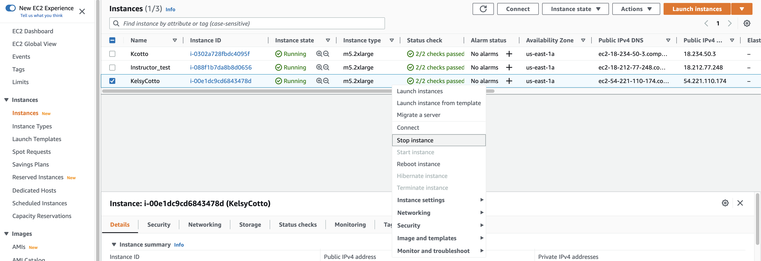
When you are done for the day you can “Stop” your instance – Don’t Terminate!
Go to AWS EC2 Dashboard, select “Instances” tab, then find your instance. Right-click and chose ‘Stop instance’

Slide 61
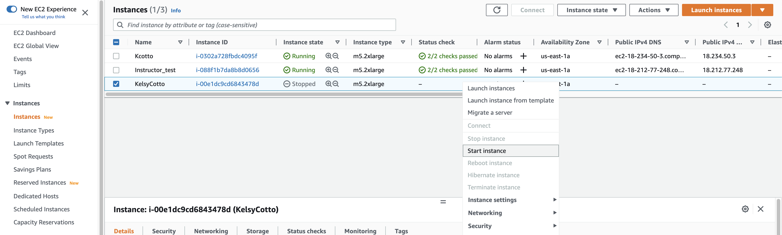
Next morning, you can “Start” your instance again
Go to AWS EC2 Dashboard, select “Instances” tab, then find your instance. Right-click and chose ‘Start Instance’

Slide 62
When you restart your instance you will need to find your new Public DNS or IP address. Select your instance and “Connect” or look in Description tab. Then go back to instructions for “Logging into your instance”

Slide 63
So, at this point:
Your laptop/pc is ready for the workshop
If it is not, you know where to get the information you need
You know how to login to AWS
The next step is to login to your linux machine on AWS and learn the basics of a linux command line

Slide 64
More concepts

Slide 65
Key AWS concepts and terminology
AWS - Amazon Web Services. A collection of cloud computing services provided by Amazon.
EC2 - Elastic Compute. An AWS service that allows you to configure and rent computers to meet your compute needs on an as needed basis.
EBS - Elastic Block Storage. A data storage solution that allows you to rent disk storage and associate that storage with your compute resources. EBS volumes are generally backed by SSD devices.

Slide 66
Key AWS concepts and terminology
S3 - Simple storage service. Cheaper than EBS and allows for storage of larger amounts of data with some drawbacks compared to EBS. S3 volumes store data as objects that are accessed by an API or command line interface or other application designed to work with S3. EBS volumes on the other hand can be mounted as if they were a local disk drive associated with the Instance.
SSD - Solid state drive. A particular type of storage hardware that is generally faster and more expensive than traditional hard drives.
Notes:
S3: longer term storage
They also have Glacier storage: which is cheaper

Slide 67
Key AWS concepts and terminology
HDD - Hard disk drive. A particular type of storage hardware that is generally cheaper and larger but slower than SSD. HDD drives are traditional hard drives that access data on a spinning magnetic disk.
Ephemeral storage - Also known as Instance Store storage. Data storage associated with an EC2 instance that is local to the host computer. This storage does not persist when the instance is stopped or terminated. In other words, anything you store in this way will be lost if the system is stopped or terminated. Instance store volumes may be backed by SSD or HDD devices.

Slide 68
What is a Region?
An AWS Region is set of compute resources that Amazon maintains (like the Data Center image shown before)
Each Region corresponds to a physical warehouse of compute hardware (computers, storage, networking, etc.).
At the time of writing there are 27 regions with more planned to come online soon: (US East (N.Virginia), US East (Ohio), US West (Oregon), US West (N. California), GovCloud (US-West), GovCloud (US-East), Canada (Central), EU (Ireland), EU (Frankfurt), EU (London), EU (Paris), EU (Milan), EU (Stockholm), Middle East (Bahrain), Middle East (UAE), Africa (Cape Town), Asia Pacific (Singapore), Asia Pacific (Sydney), Asia Pacific (Seoul), Asia Pacific (Tokyo), Asia Pacific (Mumbai), Asia Pacific (Hong Kong), Asia Pacific (Beijing), Asia Pacific (Osaka), Asia Pacific (Jakarta), Asia Pacific (Ningxia), and South America (Sao Paulo).
When you are logged into the AWS EC2 console, you are always operating in one of these regions.

Slide 69
What is a Region?
Current region shown in the upper right corner of console
It is important to pay attention to what region you are using for several reasons.
When you create an EC2 instance (EBS volume, etc) in one region you won’t see it in another region.
The cost to use many AWS resources varies by region.
The region may influence network performance when you are accessing the instance, especially if you need to transfer large amounts of data in or out.
Billing is tracked separately for each region
Generally you should choose a region that is close to you or your users. But cost is also a consideration.

Slide 70
We are on a Coffee Break & Networking Session

